Slide 1
VE281 Data Structures and Algorithms
Binary Tree Traversal
Learning Objectives:
Know the effect and procedure of pre-order, post-order, and in-order depth-first traversal
Know the effect and procedure of level-order traversal

Slide 2
Binary Tree Traversal
Many binary tree operations are done by performing a traversal of the binary tree.
In a traversal, each node of the binary tree is visited exactly once.
During the visit of a node, all actions (making a clone, displaying, evaluating the operator, etc.) with respect to this node are taken.

Slide 3
Binary Tree Traversal Methods
Depth-first traversal
Pre-order
Post-order
In-order
Level-order traversal

Slide 4
Pre-Order Depth-First Traversal Procedure
Visit the node
Visit its left subtree
Visit its right subtree
void preOrder(node *n) { if(!n) return; visit(n); preOrder(n->left); preOrder(n->right);
}
a
b
c
a→b→c
Notes:
The input argument is a pointer to a node.

Slide 5
Pre-Order Depth-First Traversal Example
a
a
b
b
c
d
g
d
e
f
h
e
g
h
i
j
i
c
f
j
a→b→d→g→h→e→i→c→f→j

Slide 6
Post-Order Depth-First Traversal Procedure
Visit the left subtree
Visit the right subtree
Visit the node
void postOrder(node *n) { if(!n) return; postOrder(n->left); postOrder(n->right); visit(n); }
a
b
c
b→c→a

Slide 7
Post-Order Depth-First Traversal Example
a
g
b
c
h
d
d
e
f
i
e
b
g
h
i
j
j
f
c
a
g→h→d→i→e→b→j→f→c→a

Slide 8
In-Order Depth-First Traversal Procedure
Visit the left subtree
Visit the node
Visit the right subtree
void inOrder(node *n) { if(!n) return; inOrder(n->left); visit(n); inOrder(n->right); }
a
b
c
b→a→c

Slide 9

What Is the Result of In-Order Depth-First Traversal?
A. g, d, h, b, e, i, a, c, f, j
B. g, d, h, b, e, i, a, f, j, c
C. g, d, h, b, i, e, a, j, f, c
D. g, d, h, b, i, e, a, f, j, c
a
b
c
d
e
f
g
h
i
j

Slide 10
Level-Order Traversal
We want to traverse the tree level by level from top to bottom.
Within each level, traverse from left to right.
a
b
c
How can we implement this traversal?
d
e
f
g
h
i
j
a→b→c→d→e→f→g→h→i→j

Slide 11
Level-Order Traversal Procedure
Use a queue!
Enqueue the root node into an empty queue.
While the queue is not empty, dequeue a node from the front of the queue.
Visit the node.
Enqueue its left child (if exists) and right child (if exists) into the queue.
Loop

Slide 12
Level-Order Traversal Code and Example
void levelOrder(node *root) { queue q; // Empty queue q.enqueue(root); while(!q.isEmpty()) { node *n = q.dequeue(); visit(n); if(n->left) q.enqueue(n->left); if(n->right) q.enqueue(n->right); } }
a
Queue:
a
b
c
d
e
f
b
c
Output:
a
b
c
d
e
f
d
e
f
Notes:
Now we show the code.

Slide 13
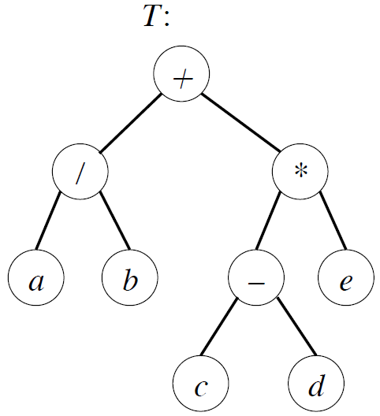
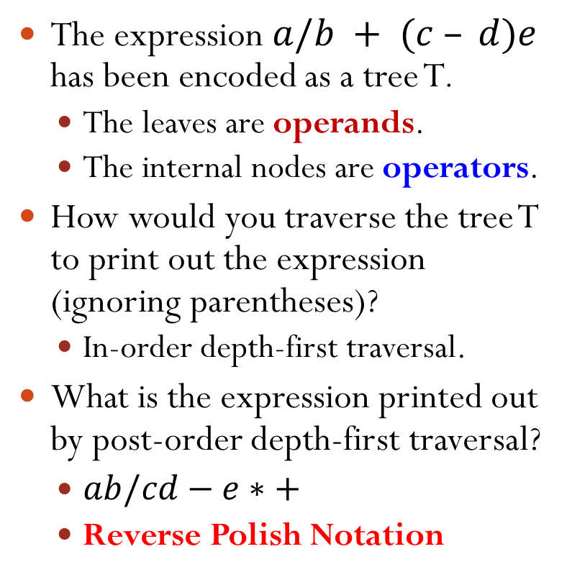
Binary Tree Traversal Application
The expression $a/b + (c – d)e$ has been encoded as a tree T.
The leaves are operands.
The internal nodes are operators.
How would you traverse the tree T to print out the expression (ignoring parentheses)?
In-order depth-first traversal.
What is the expression printed out by post-order depth-first traversal?
$ab/cd−e∗+$
Reverse Polish Notation
Notes:
In-order depth-first traversal: we ignore parentheses
Combining RPN with stack, we can obtain the expression result very easily by visiting the RPN from the beginning to the end.

Slide 14
VE281 Data Structures and Algorithms
Priority Queues and Heaps
Learning Objectives:
Know what a priority queue is
Know what a min heap is
Know how a min heap performs enqueue and extractMin operations
Know how to efficiently initialize a min heap

Slide 15
Outline
Priority Queue
Min Heap and Its Operations
Min Heap Initialization and Application

Slide 16
Priority Queues
Two kinds of priority queues:
Min priority queue.
Max priority queue.
We will focus on min priority queue.
The max priority queue is similar.

Slide 17
What Is Min Priority Queue?
A collection of items.
Each item has a key (or “priority”).
Support the following operations:
isEmpty
size
enqueue: put an item into the priority queue.
dequeueMin: remove element with min key.
getMin: get item with min key.
Notes:
It is like a queue. You can add an item into the queue or remove an item from the queue. The difference is that each item has a key and you remove items based on the order of keys.

Slide 18
Applications of Priority Queue
Banking services
VIP customer who arrives later gets served first.
Network bandwidth management
The prioritized traffic, such as real-time data, is forwarded with the least delay once it reaches the network router.
Discrete event simulation
One event happening triggers a few others, which are put into a queue.
Simulating in the order of the beginning time of the events.
Notes:
enqueue VIP customer into the priority queue based on the priority (platinum member, gold member, silver member, regular customer). Then, dequeueMin returns the one with the highest priority.
Network bandwidth management: priority is measured by the priority of the package for sending
Discrete event simulation: priority is measured by the triggering time. For example, A triggers B, C, and D. B triggers E. E may be before C and D.

Slide 19

Min Priority Queue: Implementation
A collection of items.
Each item has a key (or “priority”).
Support the following operations:
isEmpty
size
enqueue: put an item into the priority queue.
dequeueMin: remove element with min key.
getMin: get item with min key.
What’s the time complexity for an unsorted array-based implementation?
Notes:
Let n be the size. For an unsorted array-based implementation: isEmpty/size/enqueue: O(1); dequeueMin: O(n); getMin: O(n)

Slide 20
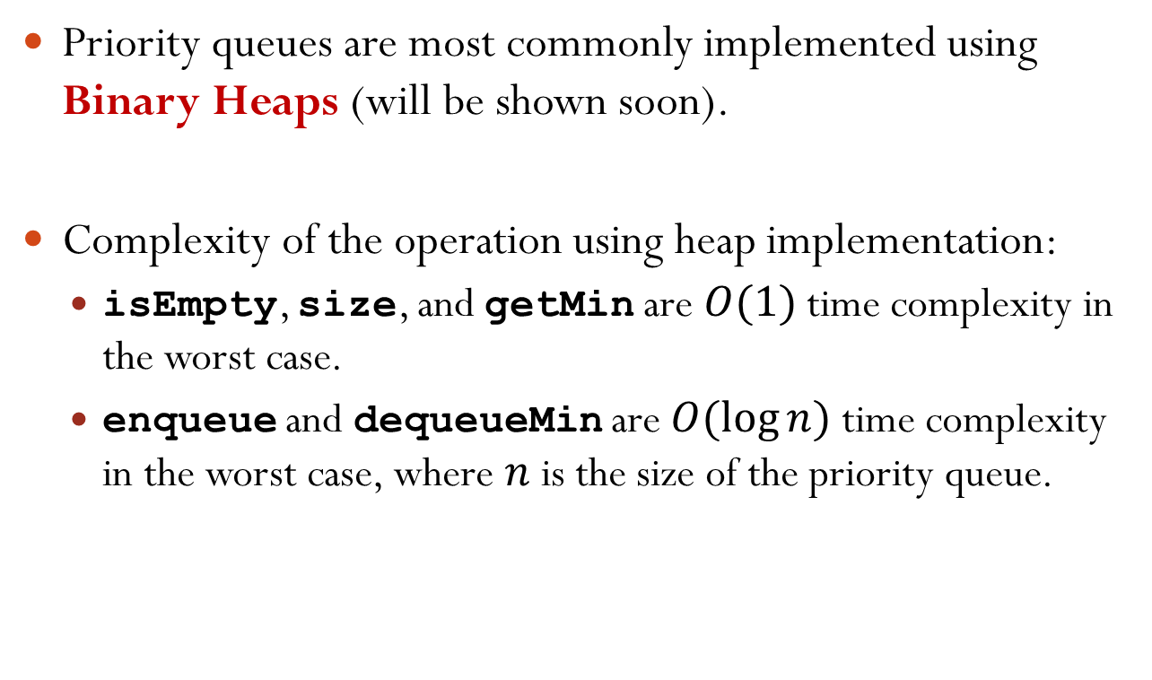
Priority Queue Implemented with Heap
Priority queues are most commonly implemented using Binary Heaps (will be shown soon).
Complexity of the operation using heap implementation:
isEmpty, size, and getMin are $O(1)$ time complexity in the worst case.
enqueue and dequeueMin are $O(\log{n})$ time complexity in the worst case, where $n$ is the size of the priority queue.

Slide 21
Outline
Priority Queue
Min Heap and Its Operations
Min Heap Initialization and Application

Slide 22
Binary Heap
A binary heap is a complete binary tree.
Notes:
Note: complete binary tree

Slide 23
Min Heap
A min heap is
a binary heap, and
a tree where for any node $v$, the key of $v$ is smaller than or equal to ($≤$) the keys of any descendants of $v$.
Property: The key of the root of any subtree is always the smallest among all the keys in that subtree.
Example
1
3
2
5
4
2
8
7
9
6

Slide 24
Min Heap
However, the keys of nodes across subtrees have no required relationship.
Binary heaps are different from binary search trees, which we will show in future lectures.
1
3
2
5
4
2
8
7
9
6

Slide 25

What’s the Height of a Heap of n Nodes?
Select all the correct answers:
A. $\left\lfloor \log_{2}{(n+1)}\right\rfloor −1$ B. $\left\lceil \log_{2}{n}\right\rceil −1$
C. $\left\lceil \log_{2}{(n+1)}\right\rceil −1$ D. $\left\lfloor \log_{2}{n}\right\rfloor$
h=3

Slide 26
Binary Heap Implementation as an Array
Store the elements in an array in the order produced by a level-order traversal.
The first element is stored at index 1.
1
1
3
2
2
3
5
4
4
5
2
6
8
7
8
7
9
9
6
10
1 | 3 | 2 | 5 | 4 | 2 | 8 | 7 | 9 | 6
[1] | [2] | [3] | [4] | [5] | [6] | [7] | [8] | [9] | [10]

Slide 27
Index Relation
1
1
Index relation allows us to move up and down a heap easily.
3
2
2
3
A node at index $i$ ($i≠1$) has its parent at index $\left\lfloor i/2\right\rfloor$.
Assume the number of nodes is $n$. A node at index $i$ ($2i≤n$) has its left child at $2i$.
If $2i>n$, it has no left child.
A node at index $i$ ($2i+1≤n$) has its right child at $2i+1$.
If $2i+1>n$, it has no right child.
5
4
4
5
2
6
8
7
8
7
9
9
6
10
Notes:
For example, node 6 has no left child, while node 5 has.
For example, node 5 has no right child.

